Slide 1

Analysis & Design of Information Systems
825200049 - AFINA PUTRI DAYANTI
825200050 - ERIC ANTHONY
825200008 - ALDI RESALDI MAULANA
PROGRAM STUDI SISTEM INFORMASI
UNIVERSITAS TARUMANAGARA

Slide 2
Solar Panel Apps (Hello World)
Framework : asp.net
Database : mysql

Slide 3
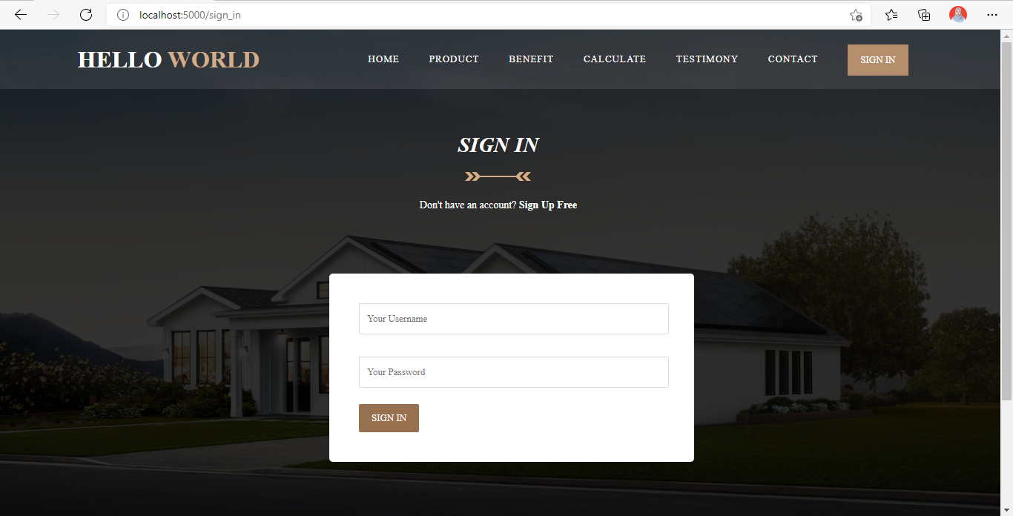
Sign In
Sign In is a screen for users to use our application with complete features. if user not signed in, the user cannot access the checkout page

Slide 4
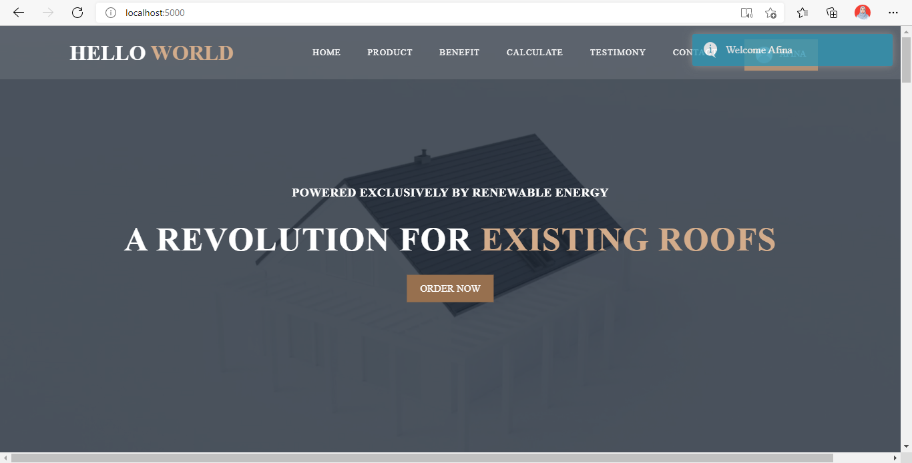
Home
Home is the initial screen of our application, if you’ve signed in the button in the upper right corner will change to your name, otherwise if you’re not signed in the button becomes the sign in button.

Slide 5
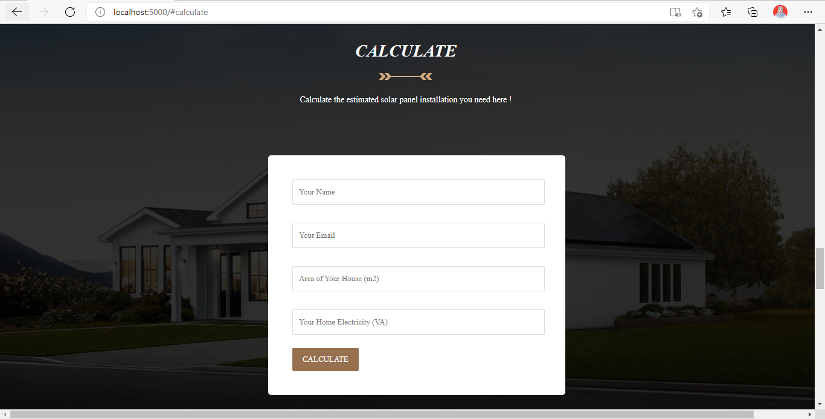
Calculate
Calculate is used to make it easier for users find out recommended solar panels according to their needs and homes. After user filled all the fields and click calculate, user will be directed to product recommendations

Slide 6
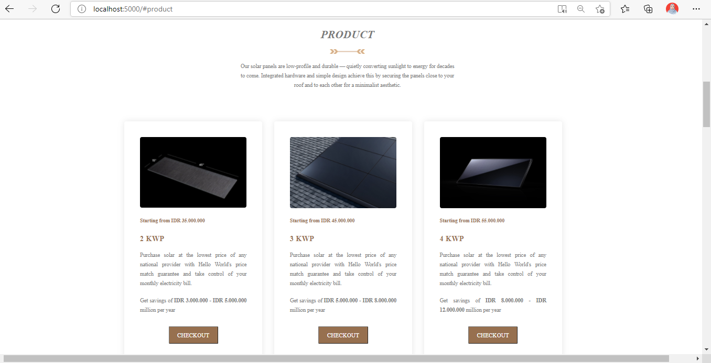
Product
Product here to show the solar panel products that we provide
There are 2KWP, 3KWP, and 4KWP

Slide 7
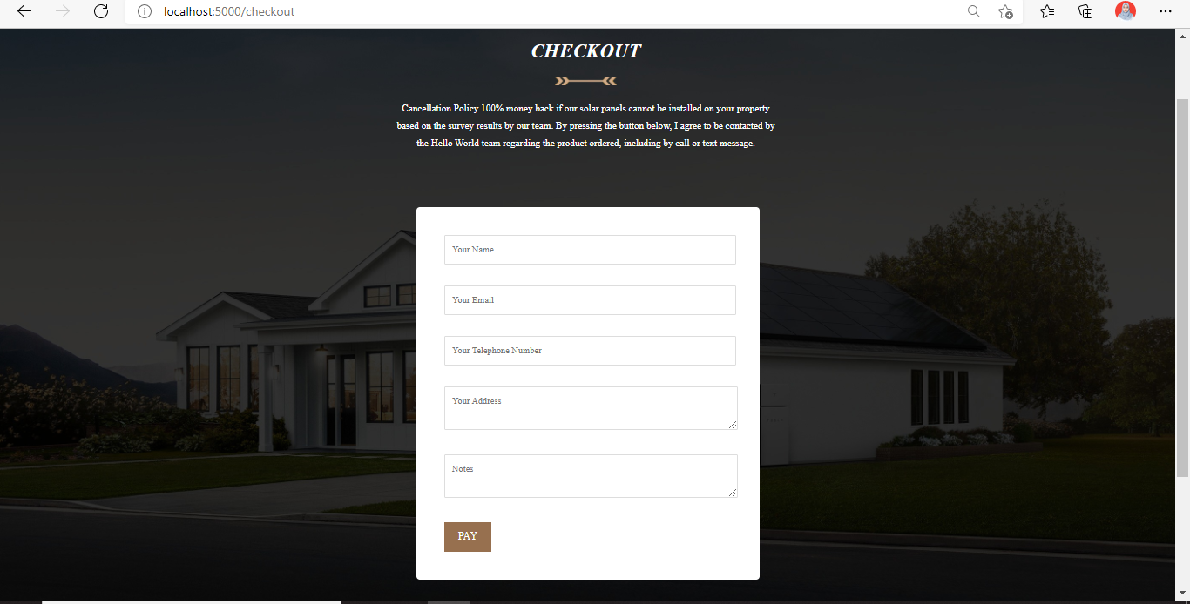
Checkout
If the user is interested in our product and wants to buy it, user can click order on the product section and will be directed to checkout page

Slide 8
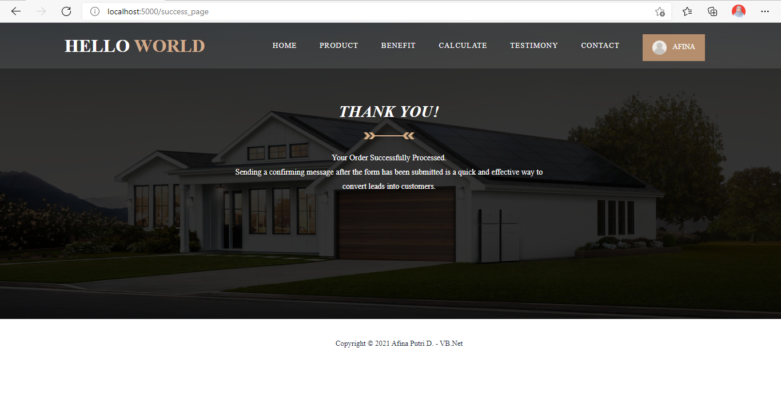
Checkout
Screen after successfully checkout

Slide 9
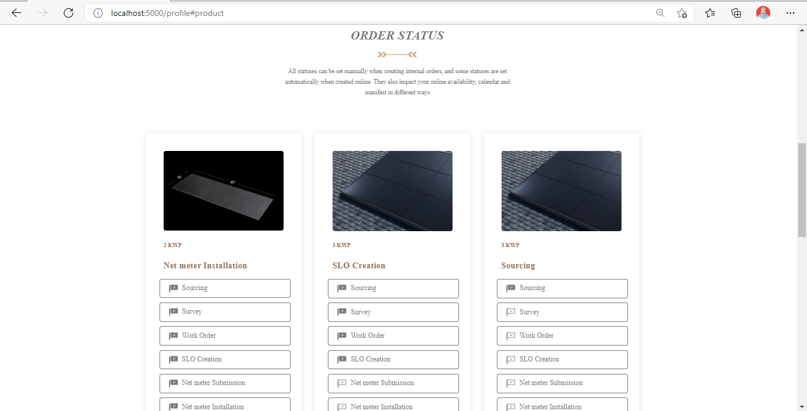
Order Status
The order status will contain the milestone tracker of the product the user purchased

Slide 10
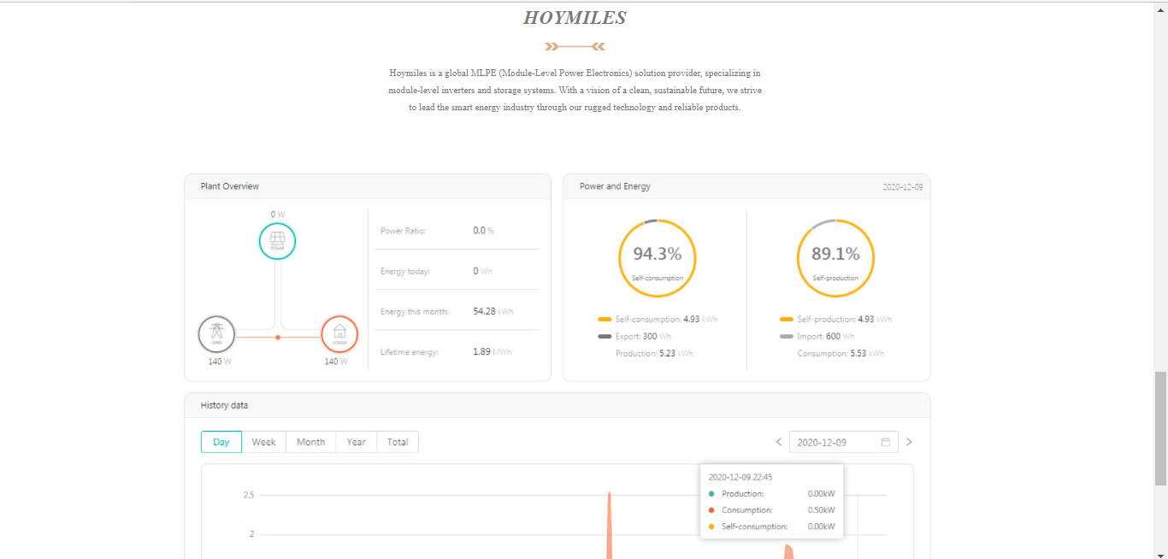
Hoymiles
Hoymiles will display a dashboard on our installed products

Slide 11
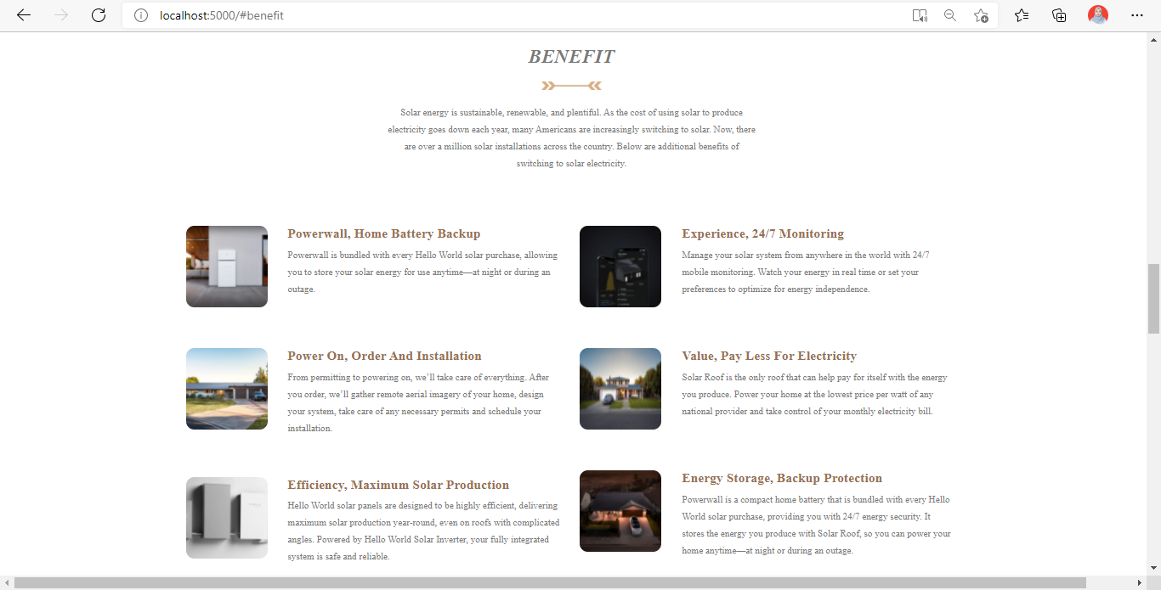
Benefit
Benefit here to tell users what are the benefits of our product

Slide 12
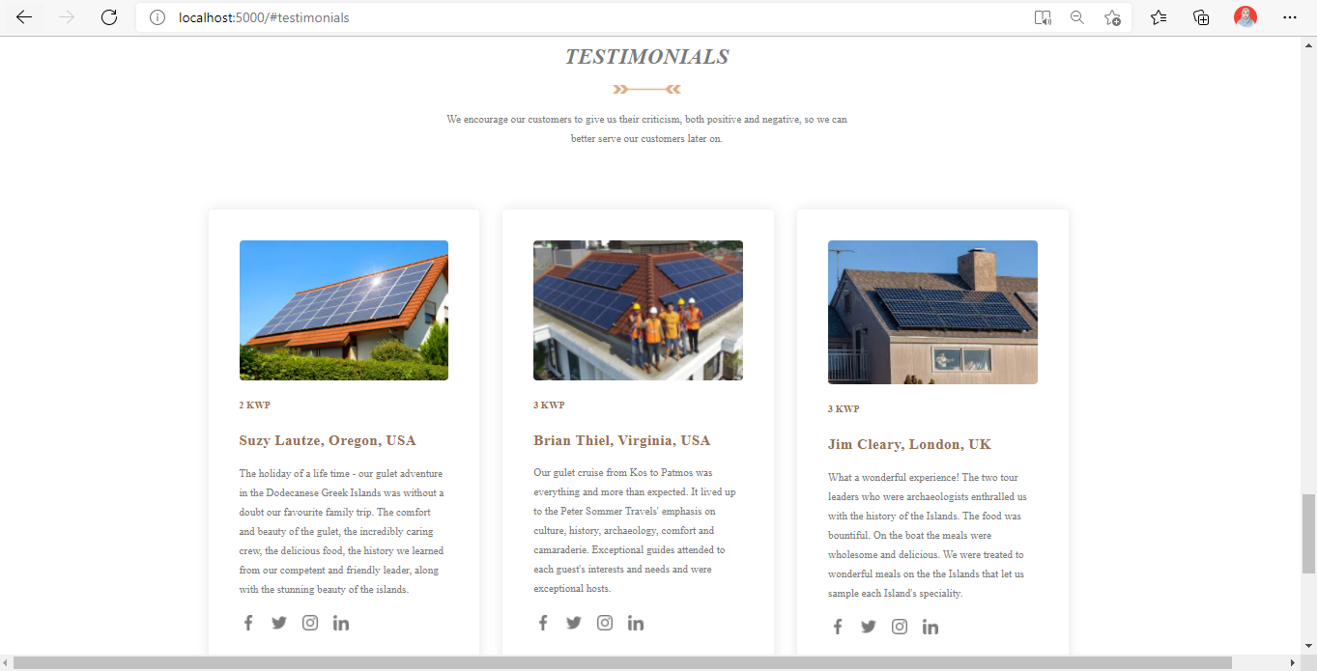
Testimonials
Testimonials screen will contain user testimonials
who have used our solar panel products

Slide 13
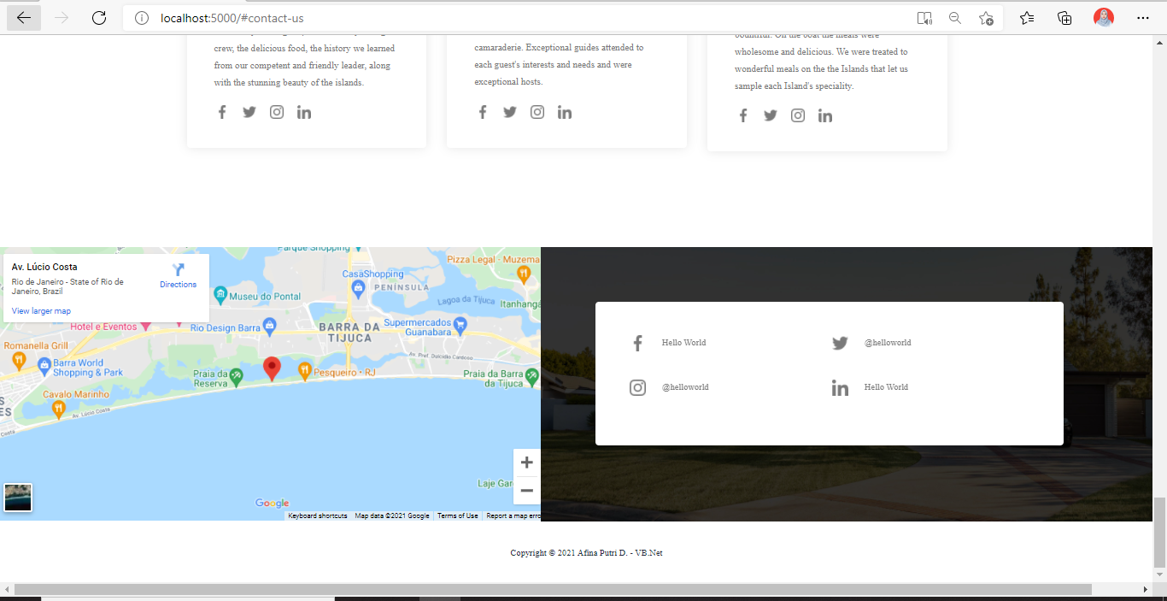
Contact Us
Contact us will contain a map of our office and social media

